Slide 1
Chap. 15 Waves
Lim Wan Hong
Sept 2012

Slide 2
Learning Outcome
(a) describe what is meant by wave motion as illustrated by vibration in ropes, springs and ripple tanks

Slide 3
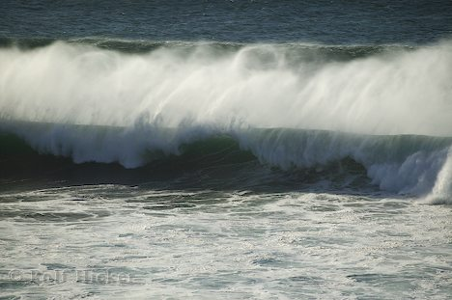
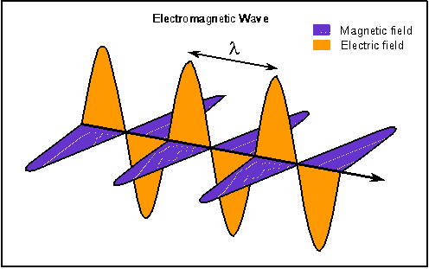
What is wave?
Water waves Electromagnetic waves

Slide 4

Wave is …
a disturbance that moves. It is a method of transferring energy.
It carries energy without carrying matter.
No particle of the medium travels between the two points.
Particles just oscillate in the medium their mean position with the same frequency as the source or origin of the wave.

Slide 5



Waves: generation & transmission media
Push a slinky spring forward & backward
2. Throw a stone into a river – ripples moving outwards
3. Oscillate a rope upwards & downwards

Slide 6
Learning Outcomes
(b) show an understanding of and use the terms displacement, amplitude, phase difference, period, frequency, wavelength and speed
(c) deduce, from the definitions of speed, frequency and wavelength, the equation v = f λ
(d) recall and use the equation v = f λ

Slide 7
terms
Displacement y
Distance
Displacement of a particle, y is its instantaneous distance from the equilibrium position.
Amplitude of a wave, A is defined as the maximum displacement of a particle from its equilibrium position.
Wavelength of a wave, λ: distance between any two points on adjacent cycles, which are vibrating in phase.

Slide 8
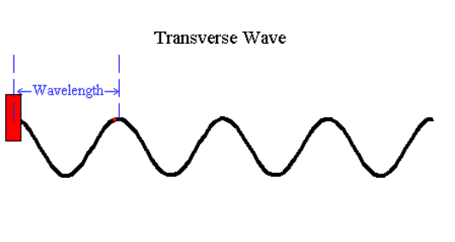

terms
P
Q
Q
Displacement y
Δx
P
Distance
λ
4. Phase difference φ between two points is the fraction of a cycle/oscillation a point has completed compared to another. The phase difference tells how much a point/wave is lagging or leading with respect to another.
= 2π when Δx= λ
P has completed one oscillation when Q is about to oscillate (in-phase)
= π when Δx= λ/2
P has completed half an oscillation when Q is about to oscillate (antiphase)

Slide 9
Phase difference
Q
Displacement y
Δx
P
Distance
4. Phase difference φ between two points on a wave or between crests of two waves of the same frequency travelling in the same medium.
P
Q
Displacement y
Δx
Distance
These two waves are Out of phase by φ

Slide 10
Terms
Period, T: time between one wave crest and the next arriving at the same point. OR time take for a point to complete one oscillation/cycle.
Frequency of a wave, f : the number of wave crests passing a given point per unit time OR The number of complete cycles of an oscillating particle per unit time
Wave Speed, v: the rate at which energy is transferred along the propagation of waves.
v = distance moved by a crest after one period / period
= λ /T = f λ as 1/T = f
The speed depends on the properties of medium in which wave is propagating.
Question:
White light has a range of wavelength from 400nm to 700 nm. Determine the range of frequencies for white light.

Slide 11
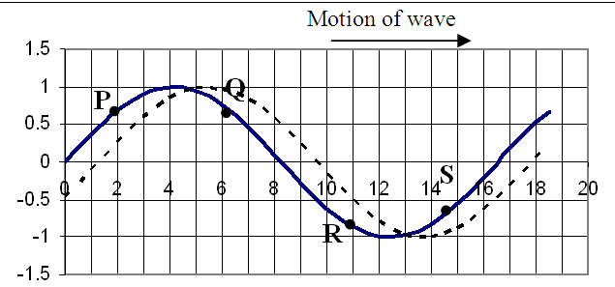
Velocity and displacement of particles in the medium of wave propagation
 | displacement | movement
P | upwards
Q |  | upwards
R | downwards
S |  | downwards
T
T

Slide 12
Learning Outcomes
(e) show an understanding that energy is transferred due to a progressive wave
(f) recall and use the relationship intensity ∝ (amplitude)²
(g) compare transverse and longitudinal waves
(h) analyse and interpret graphical representations of transverse and longitudinal waves

Slide 13
Progressive waves
Energy is transferred from the source outwards
The wave profile can be seen to move/advance in the direction of propagation of the wave, with the speed of the wave
Every point along the direction of propagation is displaced
The oscillation of the particles in a progressive wave are of the same amplitude and frequency at different distant.
Neighbouring points are not in phase

Slide 14

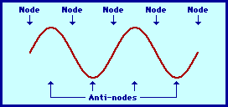
distinguish between
Electromagnetic waves | mechanical waves
doesn’t need a medium to travel – vacuum | needs a medium
Progressive waves | stationary waves
Wave profile is advancing Energy is transferred along the propagation of waves | Wave profile is not moving Energy is confined between two nodes

Slide 15

Intensity I
The rate of transfer of energy per unit area normal to the direction of propagation of the waves. I = ; unit Wm⁻² .
It is directly proportional to the square of wave amplitude A but inversely proportional to the square of distance from the source r.
I ∝ A² and I ∝ 1/ r²

Slide 16
intensity
I ∝ A²
I =k A²
I’ =k (2A)²
= k 4A²
= 4 I
Intensity | Amplitude
I | A
? | 2A
2I | ?
I =k A²
2I =k 2A²
= k (√2A)²
OR
2I =k A’² – (1)
I =k A² – (2)
A’ = √2A

Slide 17
Try this:
Two waves, P and Q, of the same frequency are travelling in the same medium. The amplitude and intensity of wave P are A and I respectively. The amplitude of wave Q is ½ A.
Determine the intensity of the resultant wave, in terms of I, when P and Q meet
in phase
antiphase

Slide 18
Questions
At a distance of 15 m from a point source of waves the amplitude of a wave is 3.2 mm and it has an intensity of 6.4 x 10⁻³ Wm⁻². Determine the intensity of the waves at distances of 40 m and 120 m from the source. [9e-4, 1e-4]
A point source of sound emits energy equally in all directions at a constant rate and a person 8 m from the source listens. After a while, the intensity of the source is halved. If the person wishes the sound to seem as loud as before, how far he is now from the source? [5.66 m]

Slide 19

Longitudinal & Transverse waves
Longitudinal waves
transverse waves
http://www.cbu.edu/~jvarrian/applets/waves1/lontra_g.htm
http://members.aol.com/nicholashl/waves/movingwaves.html
http://www.gmi.edu/~drussell/Demos/waves/wavemotion.html

Slide 20
distinguish between
Transverse waves | Longitudinal waves
A wave which is propagated by oscillations perpendicular to the direction of motion of the wave Electromagnetic wave Water wave Can be polarised | A wave which is propagated by oscillations occur in the same direction of (parallel to) the motion of the wave. Sound waves Can not be polarised

Slide 21
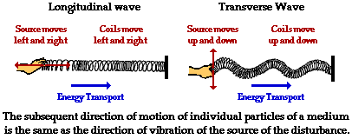
Longitudinal & Transverse waves
Slinky spring is pushed forwards and backwards at a constant rate.
A series of rarefactions and compressions occurs.
A spring is tied at one end and the other end is moved continuously up and down.
A waveform is exhibited on the spring.

Slide 22
Represent wave motion as a sine function – Transverse waves
y
motion
Displacement is measured from its equilibrium position
Displacement y
Distance

Slide 23
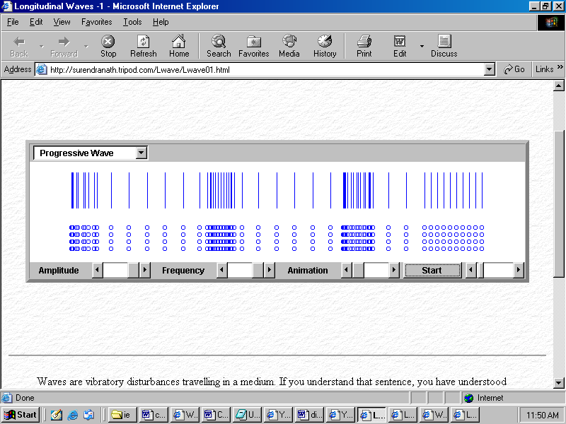
Represent wave motion as a sine function – Longitudinal waves
Displacement of a particle is measured from the equilibrium position of the particle
A series of rarefactions and compressions occurs.
λ
Displacement
Distance

Slide 24
Learning Outcomes
(i) show an understanding that polarisation is a phenomenon associated with transverse waves
(j) determine the frequency of sound using a calibrated c.r.o. *
(k) determine the wavelength of sound using stationary waves #
(l) state that all electromagnetic waves travel with the same speed in free space and recall the orders of magnitude of the wavelengths of the principal radiations from radio waves to γ-rays.

Slide 25
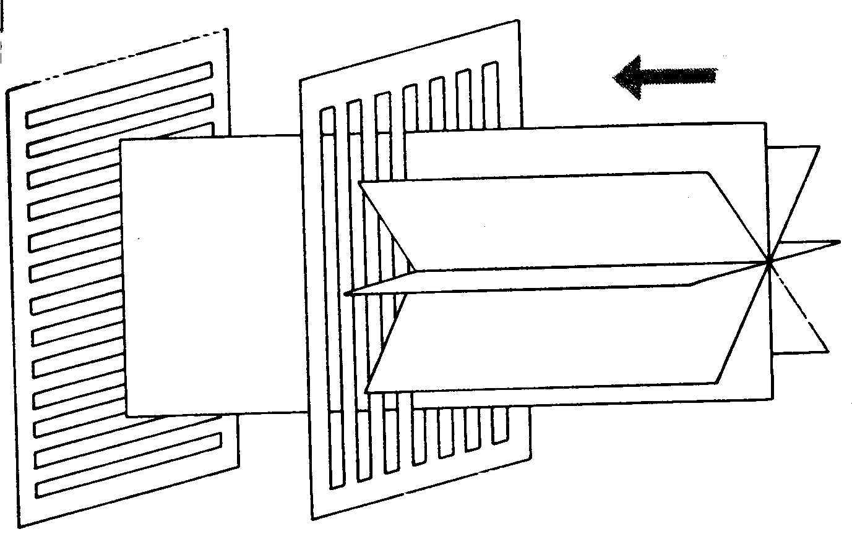
Polarisation
The restriction of the propagation of waves to a certain plane.
Vertical transmission axis on a Polaroid
Unpolarised light waves
Intensity of light after passing
through the second Polaroid?
Restriction of waves to travel on the vertical plane

Slide 26
Effects of polarisation with light.
transverse
It is the property exhibited by __________ waves only
Sunglasses
Car windscreens
Polarisation by reflection - glare/shine off roads
Polarisation of scattered sunlight
Stresses in materials
Liquid crystal displays on a calculator
Laptop displays

Slide 27
websites
Polarisation of waves (sunglasses)
http://www.colorado.edu/physics/2000/applets/polarized.html
http://physics.gac.edu/~chuck/PRENHALL/Chapter%2025/AABXTEP0.html
(Rotated Polaroid)
http://www.colorado.edu/physics/2000/applets/lens.html

Slide 28
Electromagnetic
(EM) waves
EM waves are _______________ waves with the vibrations of an __________ field and a ___________ field occurring at _________ angles to each other and in any plane at right angles to the direction of travel of the wave.
_______ medium is required
All travel with same speed in vacuum i.e._____________________
transverse
electric
magnetic
right
no
3 x 10⁸ m/s

Slide 29
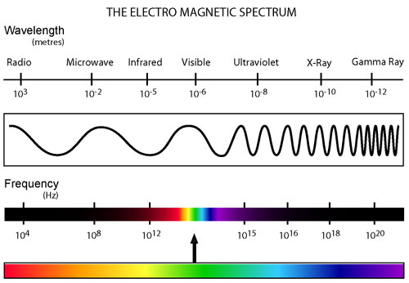
Electromagnetic waves
There is no sharp division in term of wavelength or frequency to group these 7 categories of EM waves. But, they are categorized according to how they are produced.

Slide 30
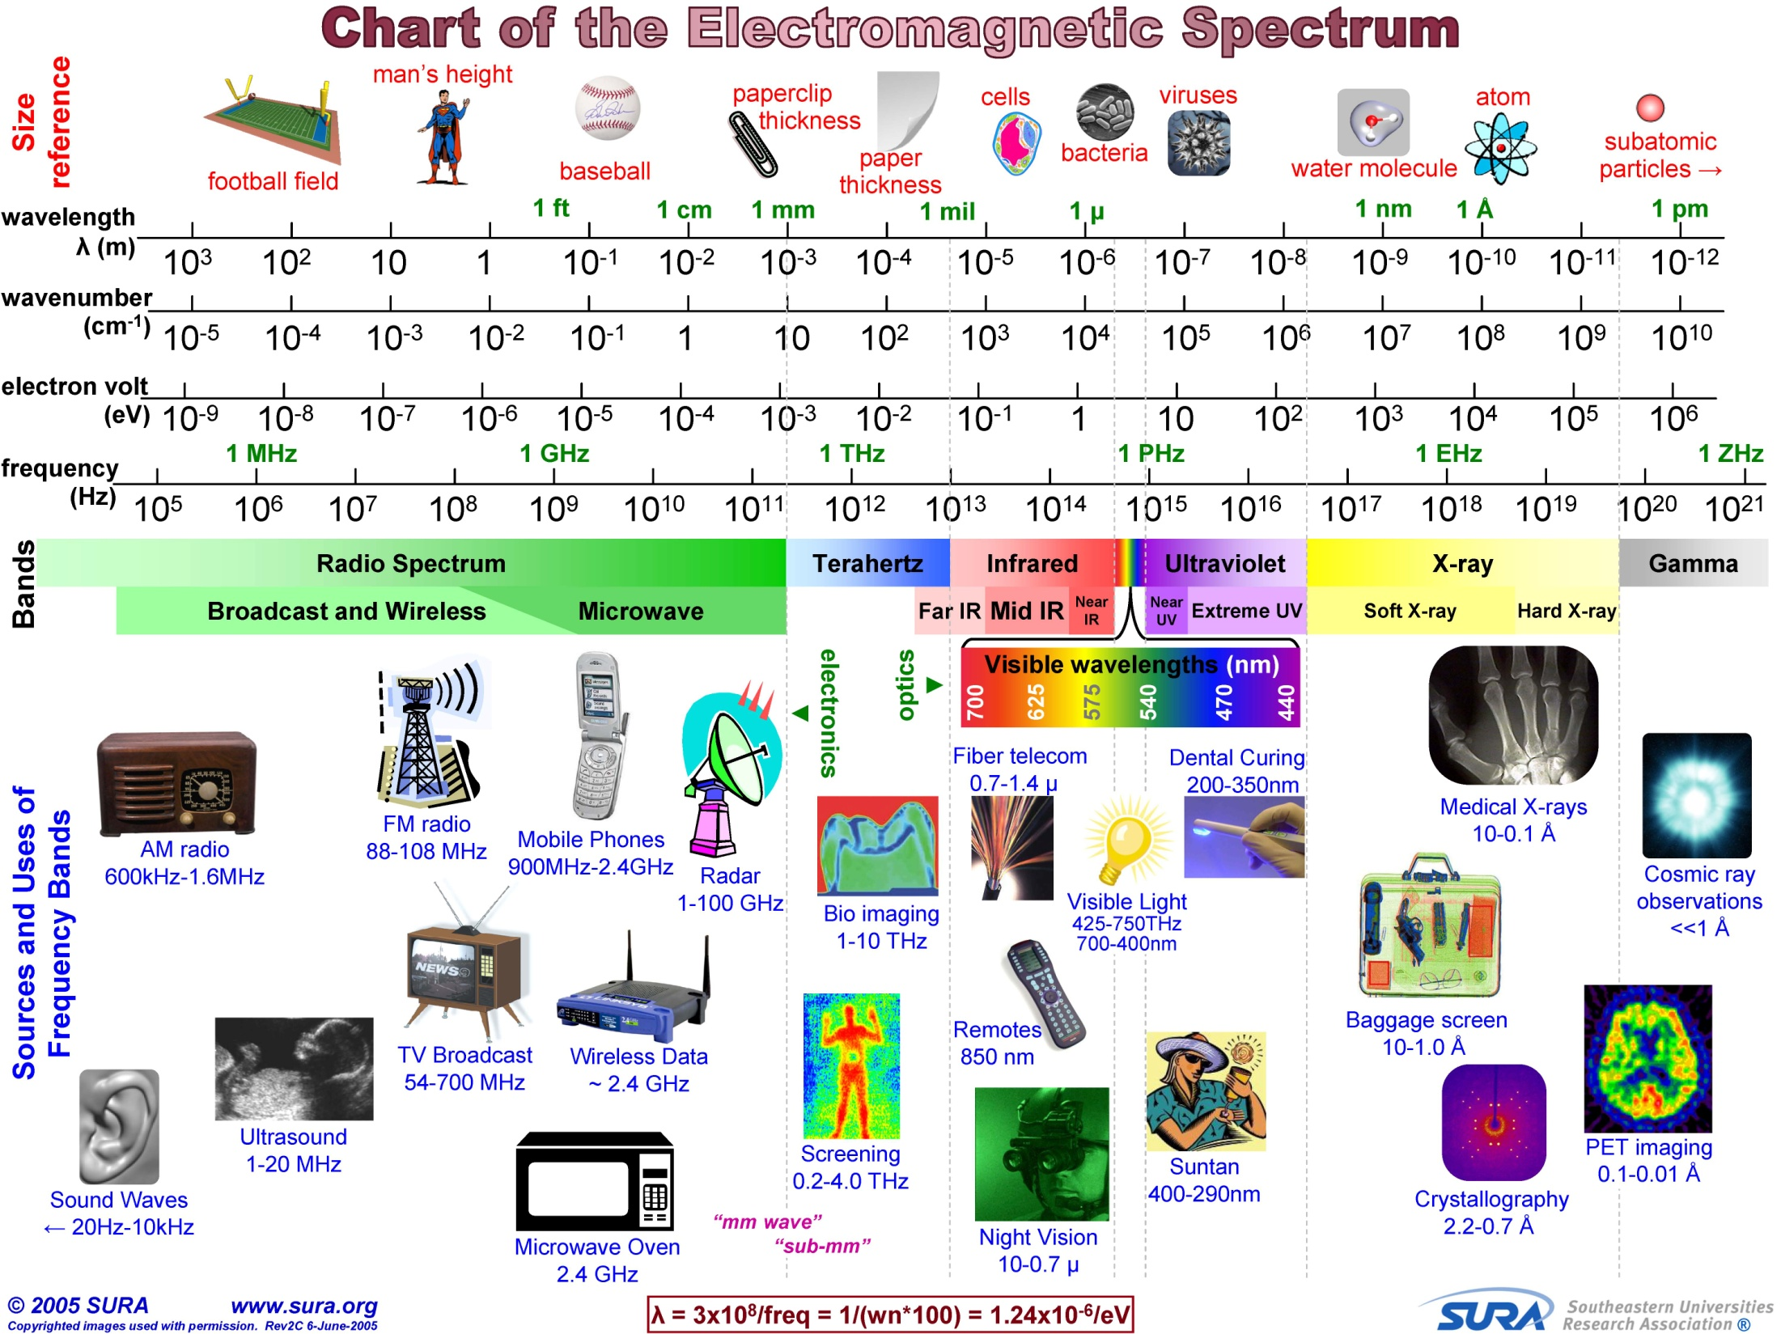

Slide 31
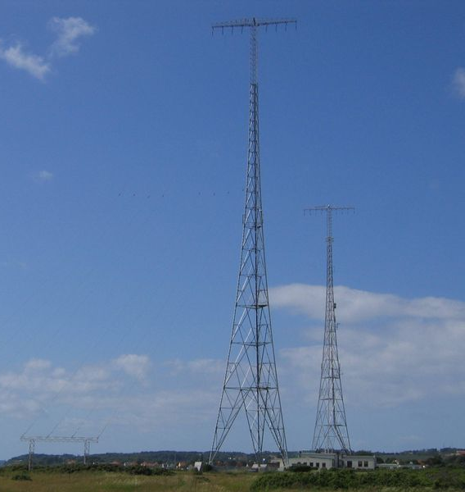
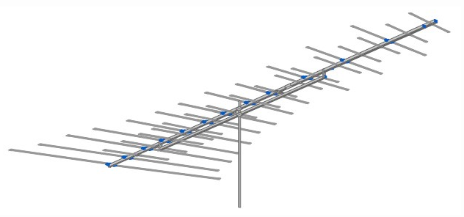
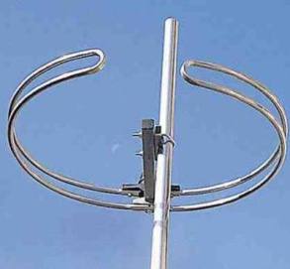

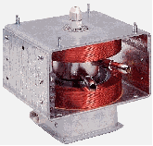
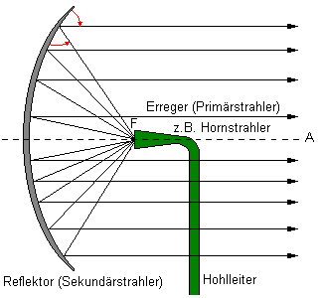
EM waves
Waves | typical wavelength /m | Source | detector
radio waves | 1000 | transmitter antenna | Receiver antenna
micro waves | 10⁻² | Magnetron, klystron | Dish antennas

Slide 32
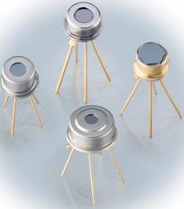
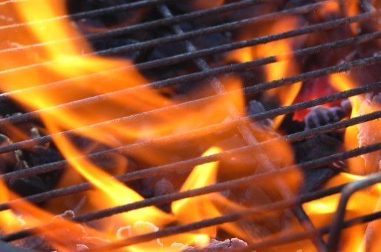

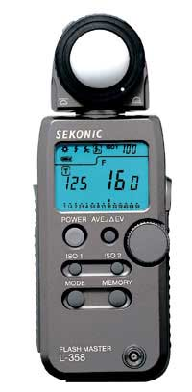
EM waves
Waves | typical wavelength /m | Source | detector
infrared | 10⁻⁴ | Hot object Heated tungsten wire | Thermopile, blackened thermometer bulb
visible light | 400n-700n | Sunlight, Laser, bulbs, | Lightmeter, eyes
BBQ

Slide 33
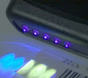
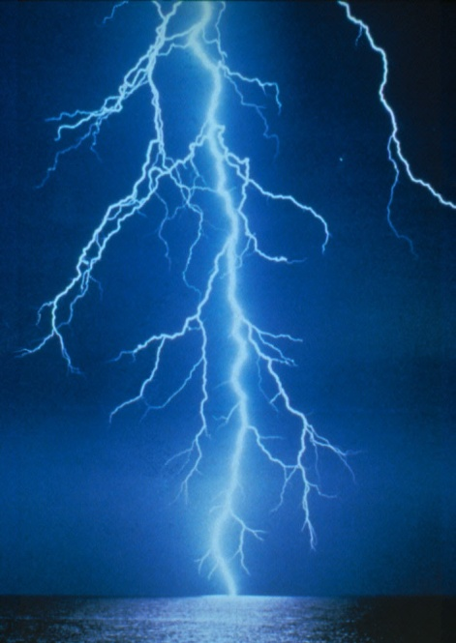
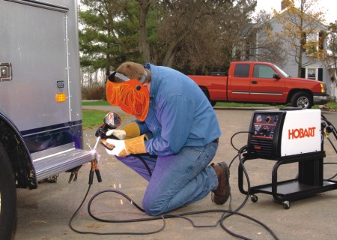
EM waves
Waves | typical wavelength /m | Source | detector
ultraviolet | 10⁻⁸ | Given off by electrical discharges e.g sparks & lightning | Photographic film, fluorescent material, photocell
visual inspection of virtually anything that contains or has been coded with fluorescent material
welding
lightning

Slide 34
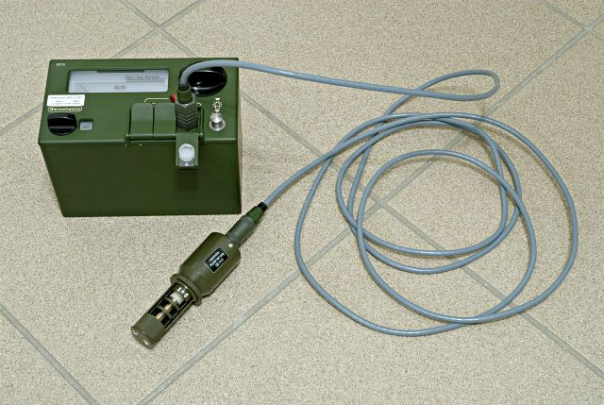
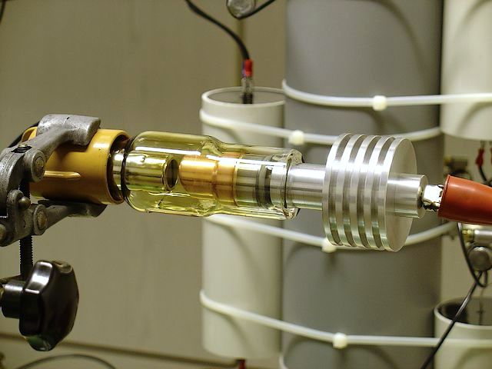
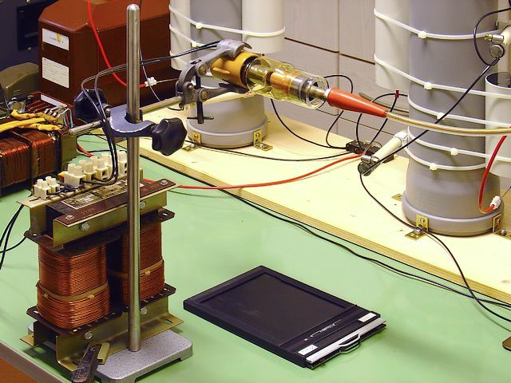
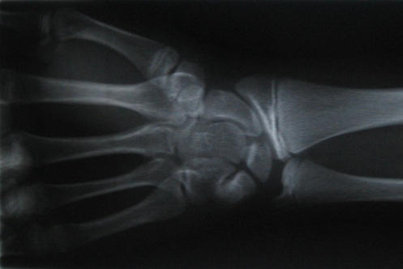
EM waves
Waves | typical wavelength /m | Source | detector
x-rays | 10⁻¹⁰ | High speed electrons decelerate quickly in x-ray tube | Photographic film, Geiger tube. scintillation counter, ionization chamber
gamma | 10⁻¹² | Radioactive nuclei
X-ray tube with heat sink
GM tube
Photographic film

